Slide 1

IMPACT OF POPULATION AGING ON CANCER INCIDENCE AND MORTALITY IN SOUTH KOREA : PROEJCTION MODEL-BASED STUDY
Prelimeinary Defense of Master Thesis
MPH Candidate Hoejun Kwon
Department of Cancer Control and Population Health
Supervisor
Hyunsoon Cho
Department of Cancer AI & Digital Health
Academic Year 2023-2024
Notes:
Hello profressor
My name is Hoejun Kwon, Thank you for joining us for today's preliminary defense
My thesis topic is “IMPACT OF POPULATION AGING ON CANCER INCIDENCE AND MORTALITY IN SOUTH KOREA : PROEJCTION MODEL-BASED STUDY”
I'll explain the table of contents on the next page

Slide 2

OUTLINE
OUTLINE
► INTRODUCTION
- Why focus on aging in cancer burden measurement?
- How to ageing in cancer burden?
- Previous study limitation? & Objective
► METHODS
- Introduction using data
- Introduction selection ageing related cancer framework
- Introduction Projection Models & Decomposition analysis
► ANALYSIS & RESULTS
-Result I
-Result II
-Result III
► DISCUSSION
► CONCLUSION & CONTRIBUTION
[ referecnced by IACR ]
Notes:
The table of contents is organized as follows
In the introduction, i briefly describe the background and goals of the study.
I will then present the methodology and data used in the study and the framework within which the study was conducted, followed by the results of the analysis.
Finally, i will discuss the significance findings, limitations, and conclusions of the study

Slide 3
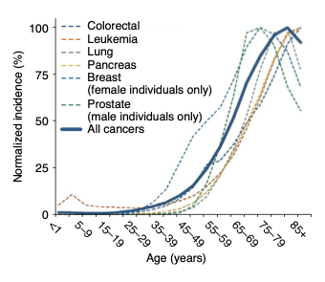
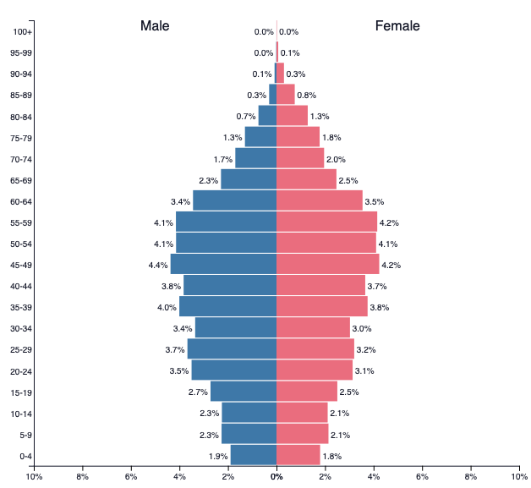
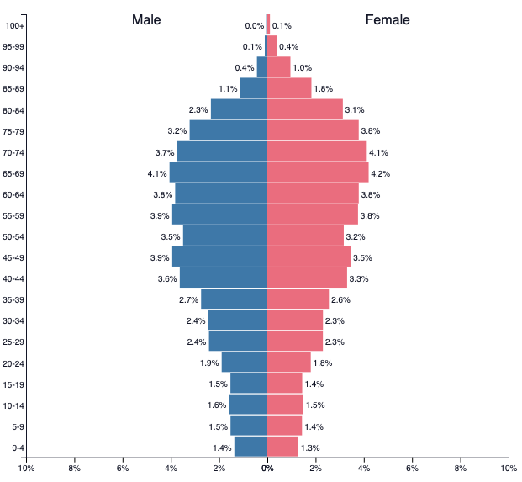

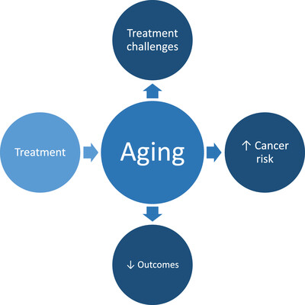
Why focus on aging in cancer burden measurement?
The importance of aging in cancer research.
Nat Aging 2, 365–366 (2022)
Understanding the interplay between cancer and aging
Changing demographics in South Korea 2019 to 2040
PopulationPyramid.net
Introduction
Methods
Analysis & Results
Discussion
Conclusions
Notes:
Previous Studies have shown that aging is strongly associated with cancer incidence and mortality.
This has the effect of accelerating the aging society.
The higher the rate of aging, the higher the burden of cancer, and the greater the social and economic challenge
In light of this, research on the burden of cancer is becoming increasingly important.s.

Slide 4
Why focus on aging in cancer burden measurement?
- SOCIAL / ECONOMIC IMPACT RESEARCH
WISDOM
KNOWLEDGE
- CANCER PREVENTION / TREATMENT POLICY
INFORAMATION
- CANCER INCIDENCE/MORTALITY TRENDS
DATA
- CANCER REGISTRIES
[DIKW PYRAMID]
Introduction
Methods
Analysis & Results
Discussion
Conclusions
Notes:
1) When looking at current research using the DIKW (Data information, knoweldge widsom) pyramid , prioritizing trends in cancer incidence and mortality can serve as a foundation for other secondary and tertiary research.
2) Therefore, in order to proceed with various studies, it is necessary to first identify trends in cancer inc idence and mortality as a preliminary study.

Slide 5

How to ageing in cancer burden?
The scope of previous research
Model1
Model2
Projection estimates
Stomach
Liver
Lung
.
.
.
Model3
Model4
Model : GLM, GAM, APC, TS…..
Introduction
Methods
Analysis & Results
Discussion
Conclusions
Notes:
1) Traditional cancer burden estimation methods utilize 2)multiple models to estimate incidence or mortality rates. 3)
But how do you quantify aging with traditional methods?
On the following pages, we discuss the limitations of existing research and our goals for this study.

Slide 6
Previous study limitation? & Objective
► Difficult to determine how much of a predicted incidence or mortality rate is affected by aging
► Fewer studies comparing different models for the same cancer type
► No comparisons of differences in model predictions across different demographics are presented, estimated value may be biased.
→ Use decomposition analysis to identify incidence, mortality contributions due to aging
→ Compare predictions from different models by cancer type
→ Employing scenario-specific prospective population projection data based on different demographic assumptions
Introduction
Methods
Analysis & Results
Discussion
Conclusions
Notes:
First, there are three main limitations of previous studies:
For each problem, we decided to do the following

Slide 7
Framework
- Comparsion by sex, cancer, model -
Model1
Model2
Projection estimates
Decomposition Analysis
Stomach
Liver
Lung
.
.
.
Model3
Population Scenarios
1) Median
2) High
3) Low
4) Fast Ageing
5) Slow Ageing
Model4
See how aging affects each cancer types (even for future populations) !!
Introduction
Methods
Analysis & Results
Discussion
Conclusions
Notes:
As a result, here's the framework we're trying to accomplish
We will perform scenario-based projections to control for various future uncertainties, and quantify the contribution of aging based on decomposition analysis.

Slide 8






Introduction using data
~1999
2000-2019
2020 ~
Age Category not exist 85+
Cancer incidence / mortality
Bias for COVID - 19
Introduction
Methods
Analysis & Results
Discussion
Conclusions
Notes:
1) Here's the data we used in our study
1)We utilized population data cancer registrations, deaths, and from KOSIS
(Koreans ststistical informations servic)
2) Data prior to 1999 was excluded due to incomplete categorizTion by age group, and data after 2020 was excluded due to concerns about underestimate bias during the COVID-19.
3) So we only used data from 2000-2019 to do our estimates.
4) Based on the scenario hypothesis set by the National Statistical Office, five scenarios were selected for projection.

Slide 9
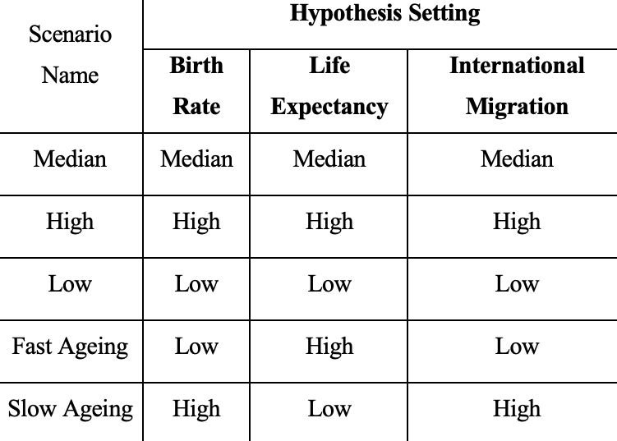
Introduction using data
~1999
2000-2019
2020 ~
Age Category not exist 85+
Cancer incidence / mortality
Bias for COVID - 19
Introduction
Methods
Analysis & Results
Discussion
Conclusions
Notes:
1) Here's the data we used in our study
1)We utilized population data cancer registrations, deaths, and from KOSIS
(Koreans ststistical informations servic)
2) Data prior to 1999 was excluded due to incomplete categorizTion by age group, and data after 2020 was excluded due to concerns about underestimate bias during the COVID-19.
3) So we only used data from 2000-2019 to do our estimates.
4) Based on the scenario hypothesis set by the National Statistical Office, five scenarios were selected for projection.

Slide 10
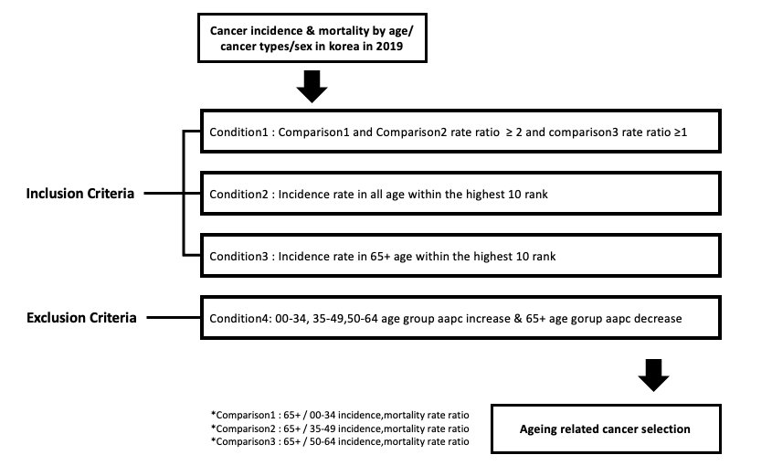
Introduction selection ageing related cancer framework
Dominant or not?
Contribution high or not
- Introduction selection ageing related cancer framework
Shifting or not?
Ageing related cancer selection framework
Introduction
Methods
Analysis & Results
Discussion
Conclusions
Notes:
Due to the large number of cancers available, we decided to limit ourselves to cancers that are expected to be highly affected by aging.
It has been developed based on the conditions that take into account the changes in rate ratios by age group and patterns in incidence and mortality by age group in previous studies.
We selet for ageing related cancers by determining fit within four broad ranges.

Slide 11
Introduction projection methods & decomposition analysis
[ Selection Projection Method ]
Category | Model | Name
Population Struture -based | GLM | Age-Drift-Period-Cohort (Nordpred)
 | APC | Bayesian-Age-Period-Cohort
Non-Population structure-based | GLM | JOINPOINT
 | Time Series Model | ARIMA
 |  | Space-State Model Linear
* Population Struture –based: Consider incidence / mortality rates by age group and incidence / mortality rates for all ages when making predictions.
*Non-population Struture –based: Predictions are made using incidence and rate over time (no population data is used).
Introduction
Methods
Analysis & Results
Discussion
Conclusions
Notes:
The models used in the study were selected as representative of many existing studies and were divided into two types to differentiate between the models.
first category is population -struvture based model, second cateogry is non population structure based model
According to this categorization, each model is either directly influenced by population data or not.

Slide 12
Introduction projection methods & decomposition analysis
[ Decomposition Analysis ]
Population Ageing
Incidence / Mortality Case
Population Growth
Rate Change
Case
Case
. . .
. . .
[Ref]
Time
Time
See how each factor contributed to the increase in incidence or deaths compared to the referecne year
Introduction
Methods
Analysis & Results
Discussion
Conclusions
Notes:
The decomposition method separates the number of incidents or deaths by attribution.
After setting a reference year (for example, incidence reference year is 2000, and mortality refernce year is 2005), the difference in incidents or deaths compared to that year can be separated into three components
This is how we can determine the contribution of aging.

Slide 13
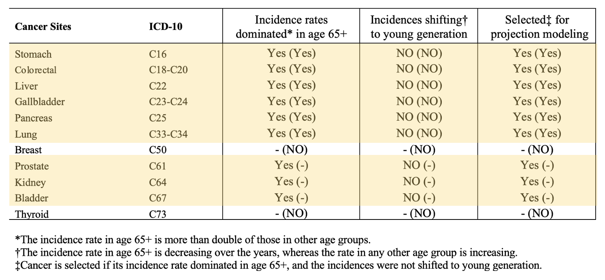
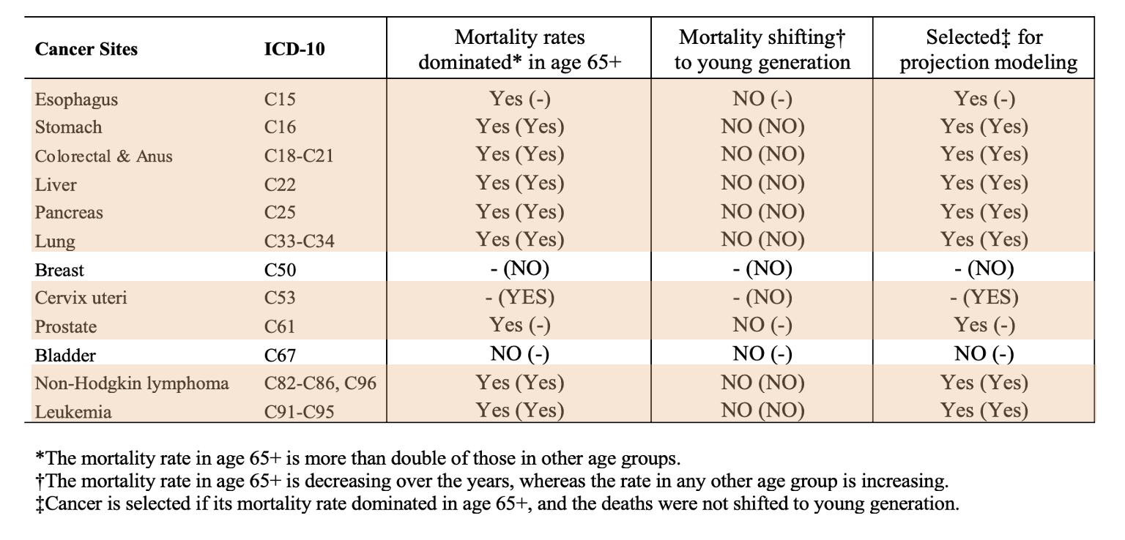
Result I: Selection ageing-related cancer
Cancer selection for the model projection with adjustment on ageing population in incidence/mortality by sex. ** Male (Female) **
1) For men, cancer of the esophagus and urinary system were specifically included (excluding bladder cancer from mortality) 2) For women, female-specific can cancer were not included (cervix excluded from mortality) 3) All cancers of the stomach, liver, colorectal, pancreas, and lung, which are considered major cancers for previous studies, were included 4) Gallbladder cancer was significant in all sex for incidence only
Introduction
Methods
Analysis & Results
Discussion
Conclusions
Notes:
First, aging related cancer were selected based on the criteria
The Major five most common cancers were significant for both men and women, and Some cancers had different significance by sex.

Slide 14
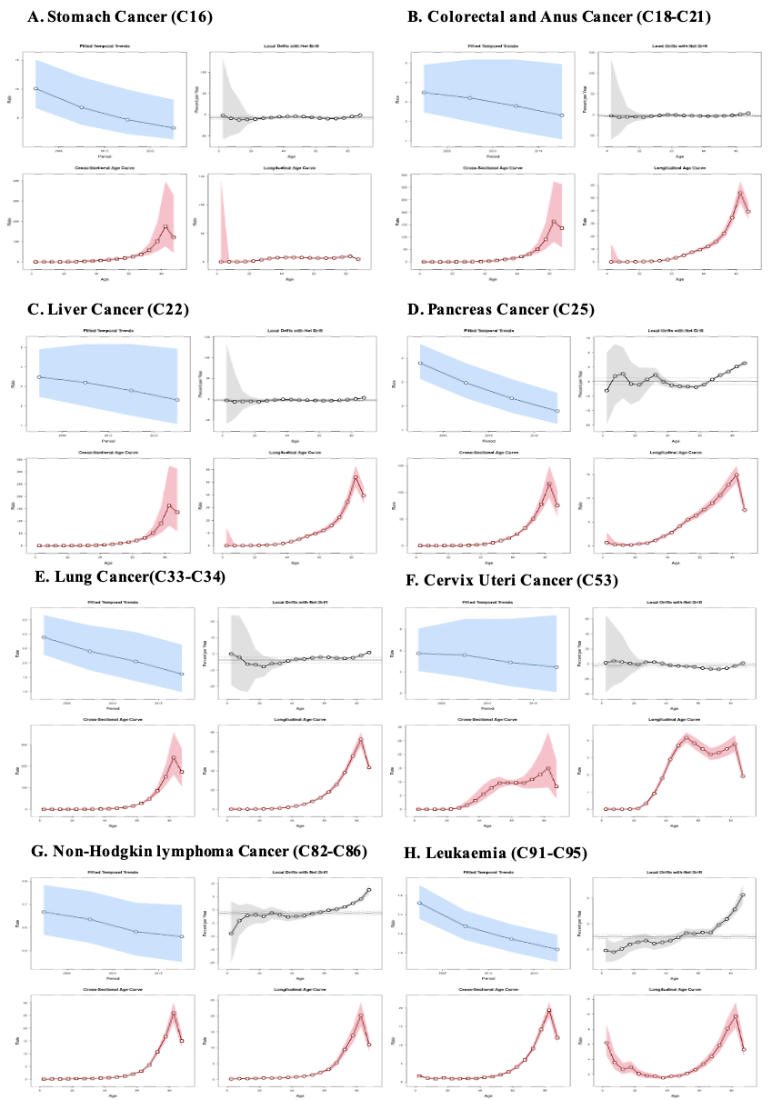
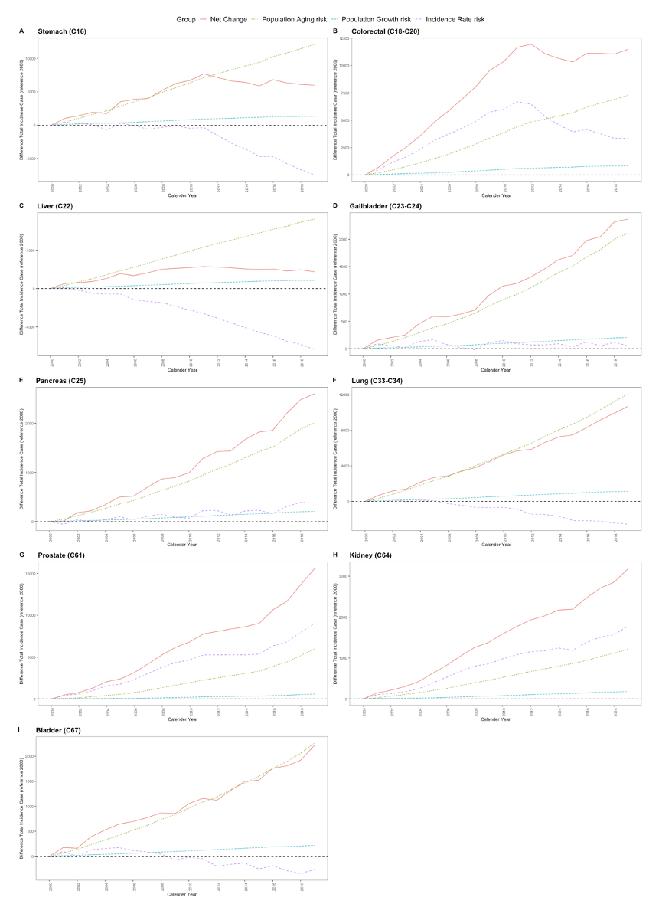
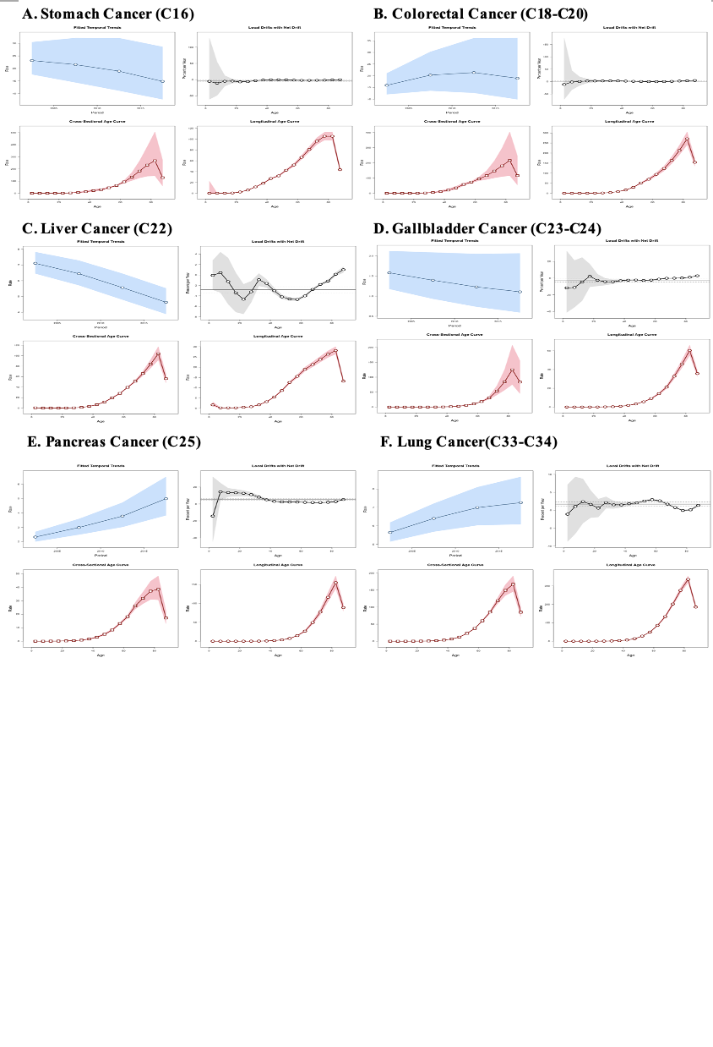
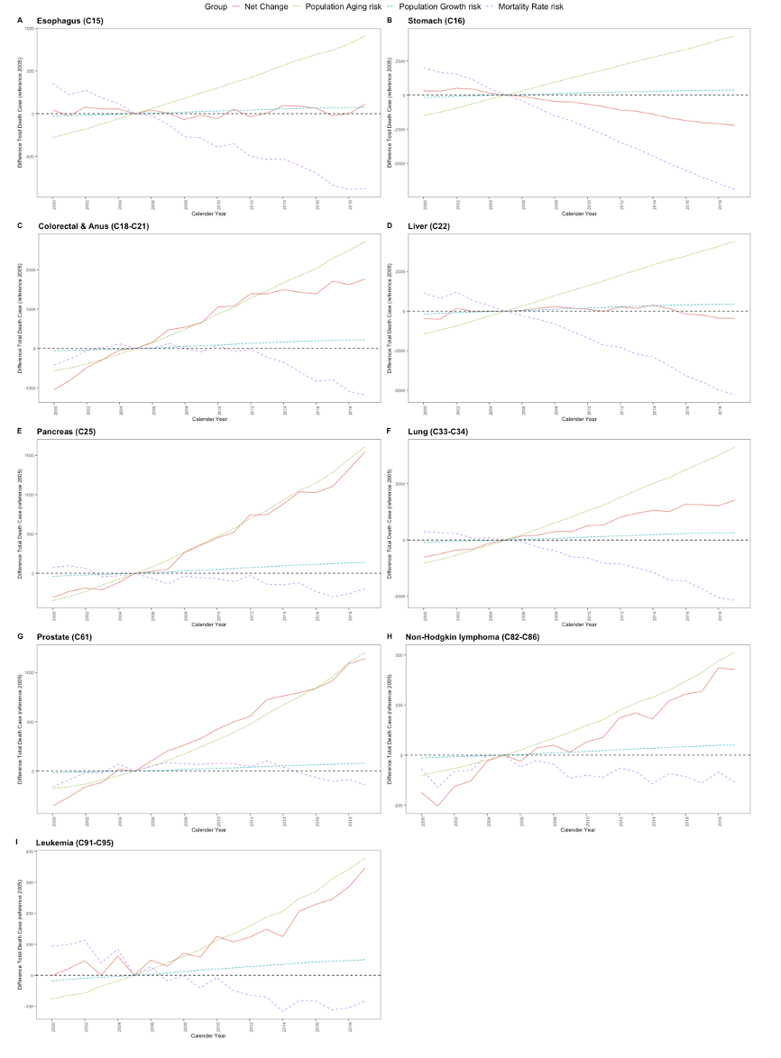
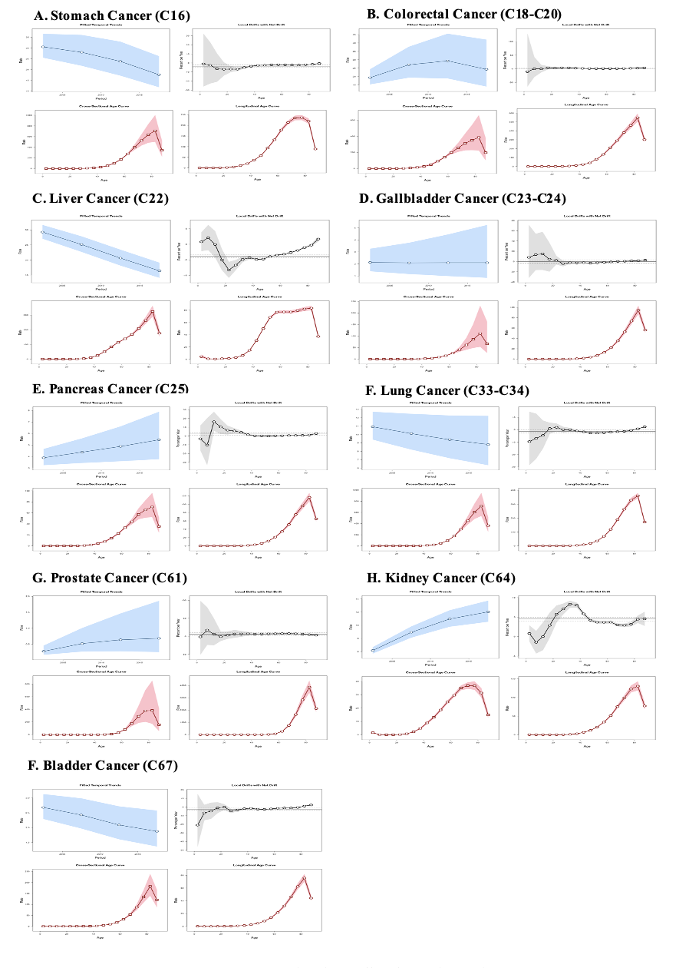
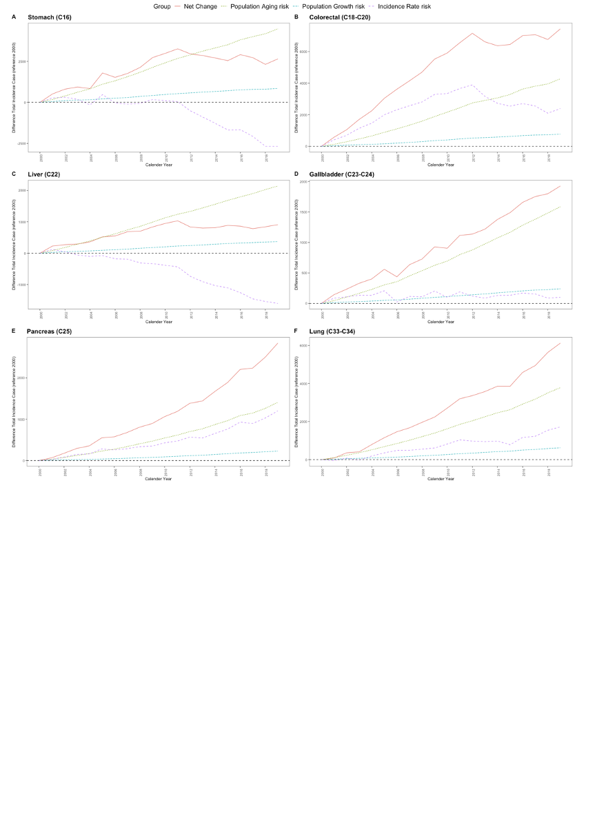
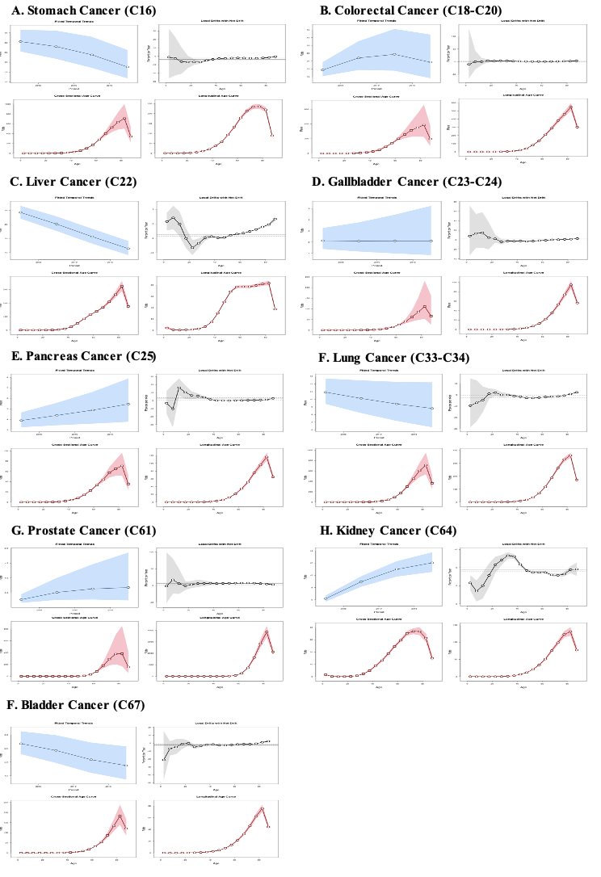
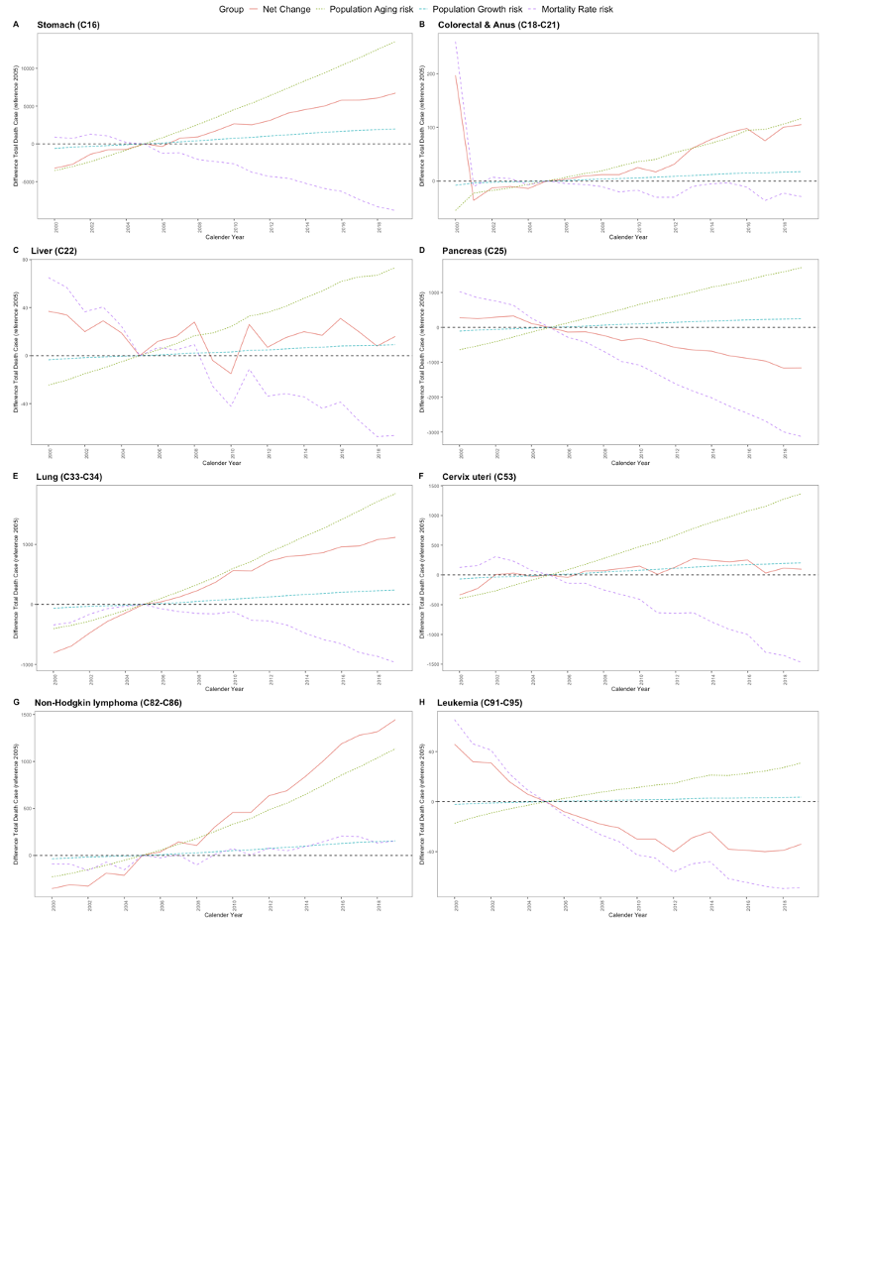
Result I: Validation ageing-related cancer
[ Age-Period-Cohort Analysis ]
[ Decomposition Analysis]
Incidence and mortality rates were higher in older age groups, with increasing or constant trends over time in terms of age and cohort.
The increase in ageing is accounted for of all cases or deaths by sex as major factor.
Introduction
Methods
Analysis & Results
Discussion
Conclusions
Notes:
We used Age period cohortand decomposition analysis to test the validity of the selected cancer types.
The APC analysis confirmed the high incidence/mortality in the older age groups by age and cohort, and the decomposition analysis confirmed the contribution of aging as a major factor.
1) The figures are too small, so let's zoom in to see what the trends are.
To interpret each figure, the top left shows the increase and decrease across all ages.
The top right shows the average increase/decrease over the entire observation period by age group.
The bottom left shows incidence/mortality rates by age, and the bottom right shows incidence and mortality rates by cohort age.
On the right side is a three-component decomposition of the difference in incidence / mortality from the reference year.
The net change is the actual difference in incidence or deaths from the reference year, the ageing facotr is the contribution of incidence or deaths due to population aging, and the other two factors are the contribution of population growth and the contribution of changes in age-specific incidence or mortality rates, respectively.
Through both analyses, we found that all selected cancers were significantly higher in older age groups and that aging continues to affect cancer incidence and death.

Slide 15
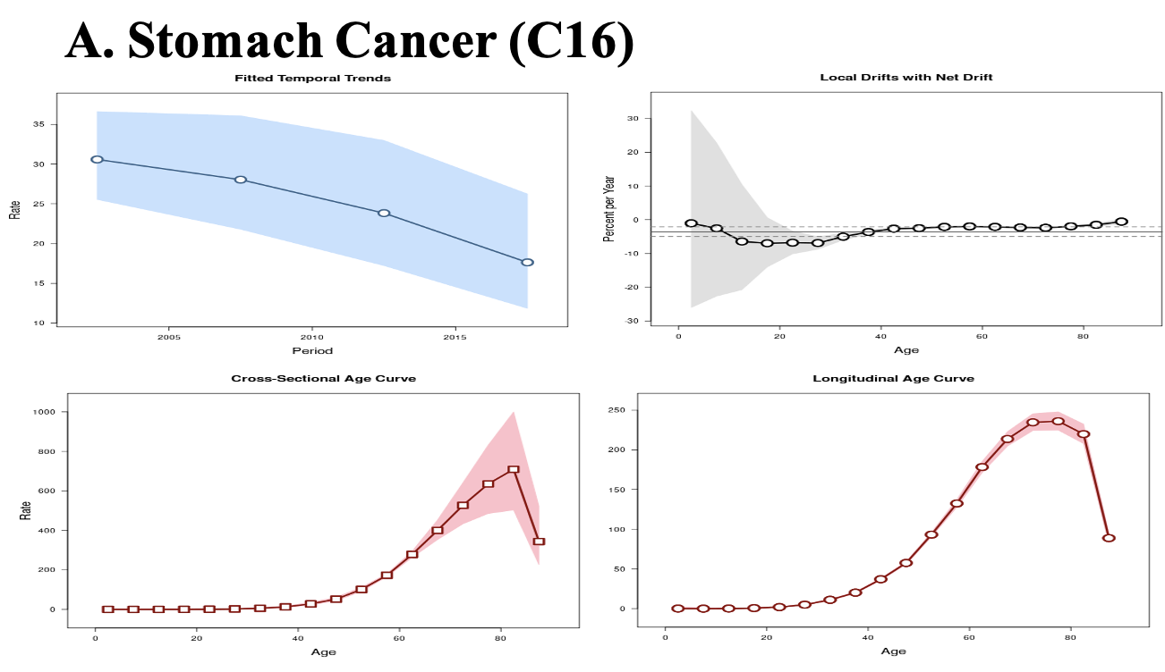
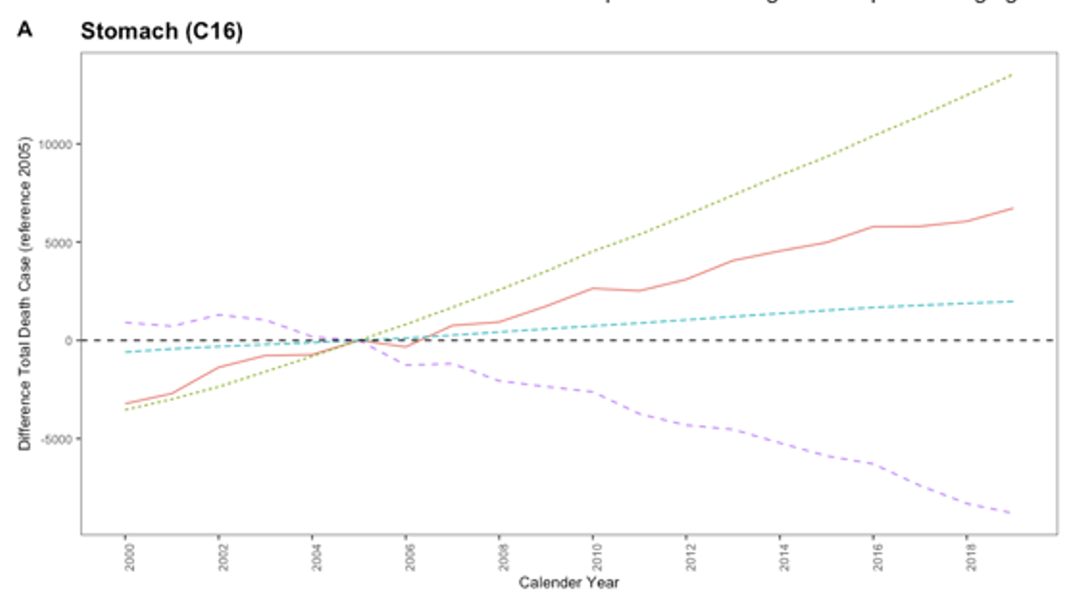
Result I: Validation ageing-related cancer
[ Age-Period-Cohort Analysis ]
[ Decomposition Analysis]
Incidence and mortality rates were higher in older age groups, with increasing or constant trends over time in terms of age and cohort.
The increase in ageing is accounted for of all cases or deaths by sex as major factor.
Introduction
Methods
Analysis & Results
Discussion
Conclusions
Notes:
We used Age period cohortand decomposition analysis to test the validity of the selected cancer types.
The APC analysis confirmed the high incidence/mortality in the older age groups by age and cohort, and the decomposition analysis confirmed the contribution of aging as a major factor.
1) The figures are too small, so let's zoom in to see what the trends are.
To interpret each figure, the top left shows the increase and decrease across all ages.
The top right shows the average increase/decrease over the entire observation period by age group.
The bottom left shows incidence/mortality rates by age, and the bottom right shows incidence and mortality rates by cohort age.
On the right side is a three-component decomposition of the difference in incidence / mortality from the reference year.
The net change is the actual difference in incidence or deaths from the reference year, the ageing facotr is the contribution of incidence or deaths due to population aging, and the other two factors are the contribution of population growth and the contribution of changes in age-specific incidence or mortality rates, respectively.
Through both analyses, we found that all selected cancers were significantly higher in older age groups and that aging continues to affect cancer incidence and death.

Slide 16

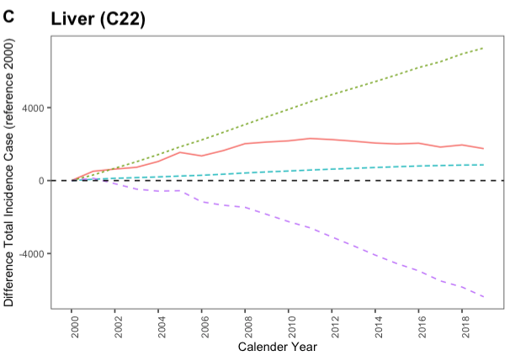
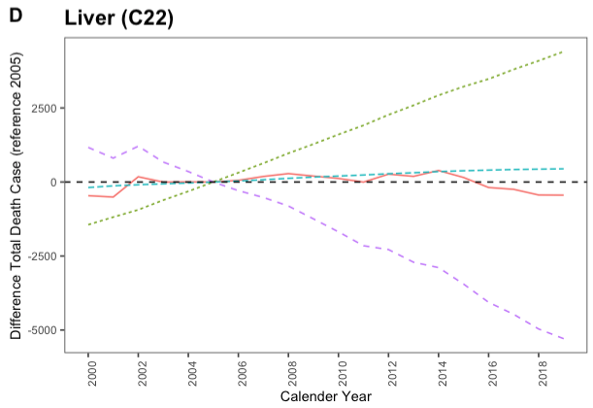
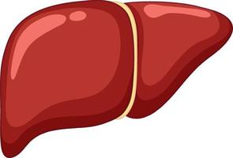

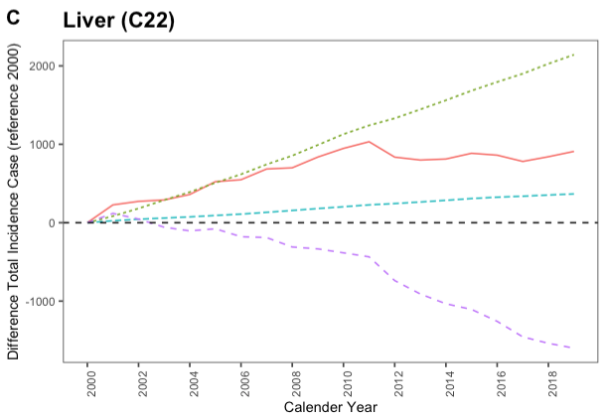
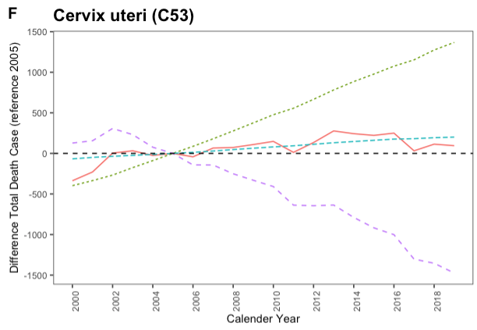

Result I: Which cancers are most affected by aging?
Incidence
Mortality
Liver
Liver
2000 | 2005 | 2010 | 2015 | 2019
0 | 119.7 | 179.1 | 288.7 | 414.6
2000 | 2005 | 2010 | 2015 | 2019
312.3 | 0 | 1325.3 | 2105.6 | 989.8
Ageing factor contribution case / net change case
Incidence
Mortality
Liver
Cervux Ulteri
2000 | 2005 | 2010 | 2015 | 2019
0 | 97.3 | 119.1 | 190.2 | 235.7
2000 | 2005 | 2010 | 2015 | 2019
117.9 | 0 | 322 | 440.3 | 1439.6
Introduction
Methods
Analysis & Results
Discussion
Conclusions
Notes:
Let's look at the cancers that showed the largest increase in the previous results.
The result is a ratio of the contribution to the aging effect to the net change.
For both incidence and mortality, liver cancer is strongly associated with aging in men, and for women, liver cancer is strongly associated with aging in incidence, but cervical cancer is strongly associated with aging in mortality.

Slide 17
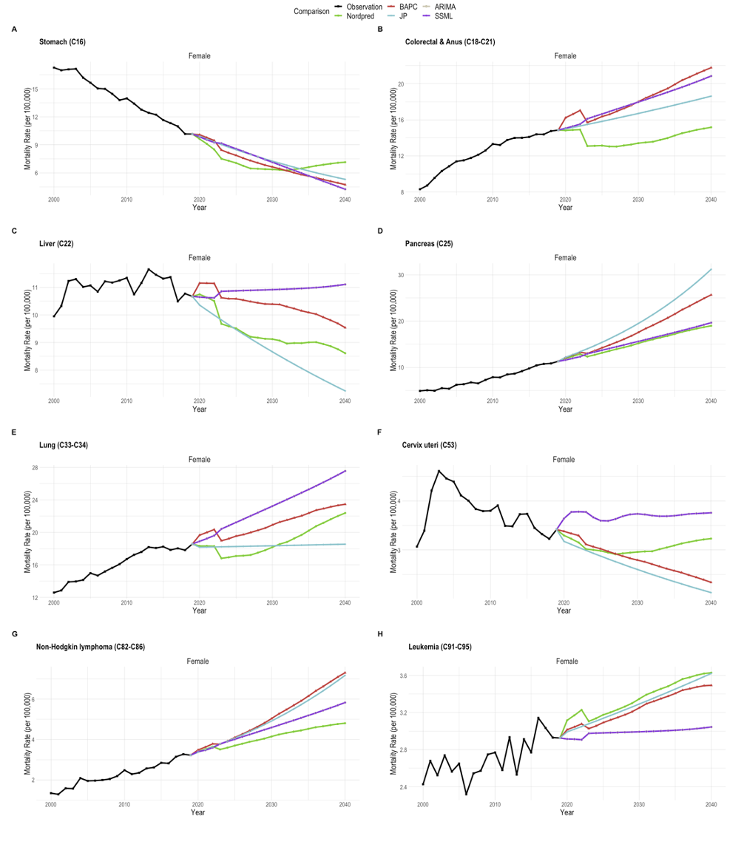
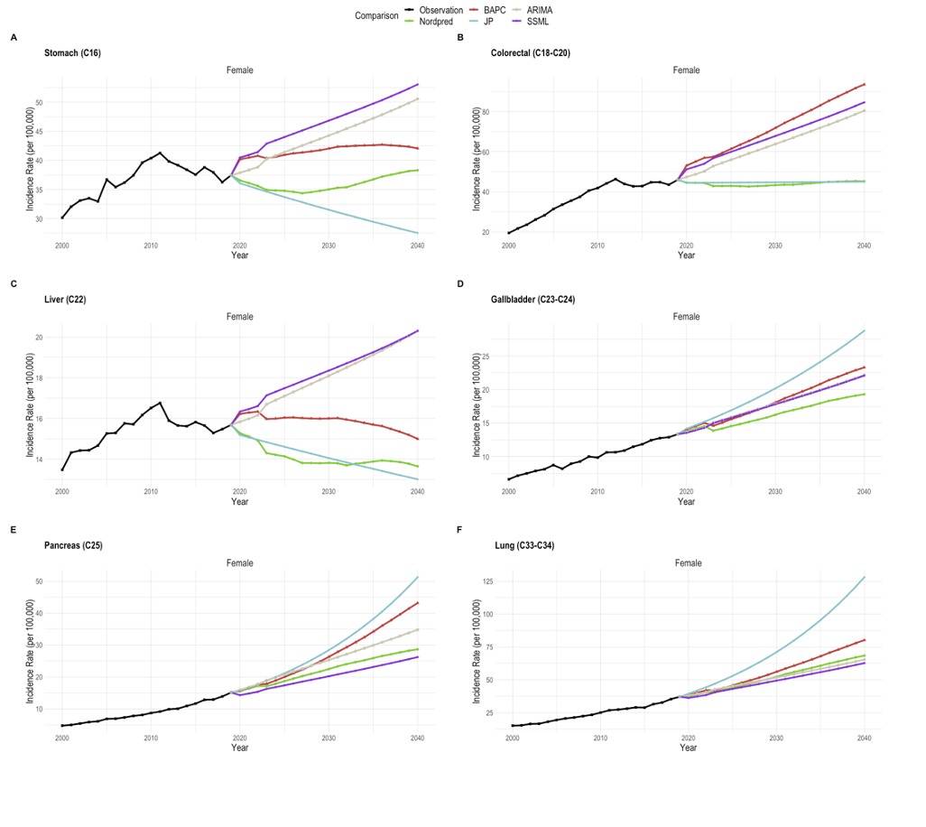
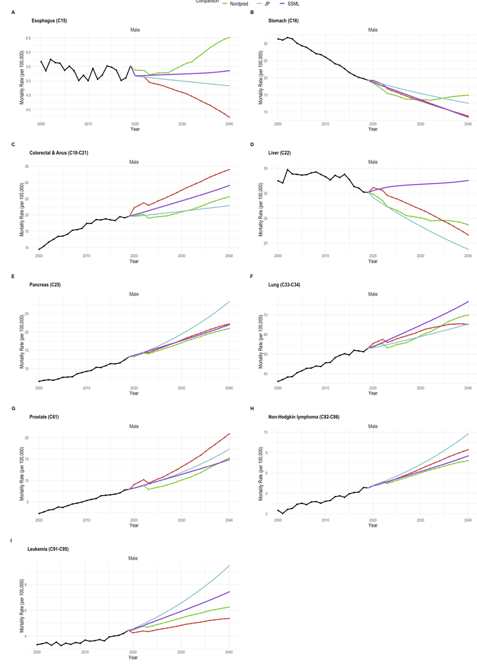
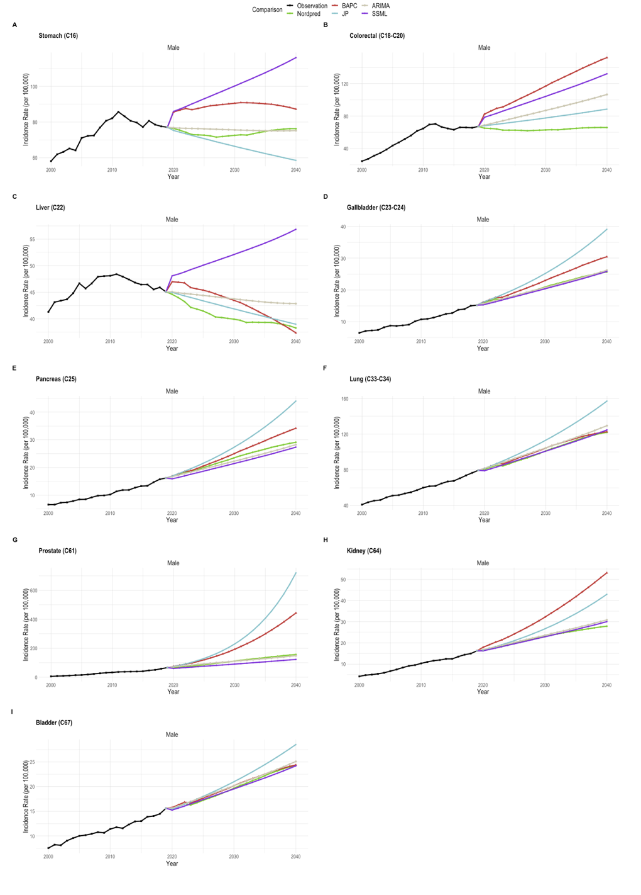
Result II: Compare projections from different models by sex, cancer type
Compare differences
between models based on prediction trends
Is the pattern of increase or decrease the same across models?
Do suggest similar predictions by models
Proejction by model, sex, cancer type
Introduction
Methods
Analysis & Results
Discussion
Conclusions
Notes:
We wanted to see the difference in projection estimates based on the selected cancers.
We wanted to compare the two in the following ways
Is the pattern of increase or decrease the same across models?
Do suggest similar predictions by models

Slide 18
Result II: Compare projections from different models by sex, cancer type
Similar Trend
Incidence | Mortality
Gallbladder (C23-C24) Pancreas (C25) Lung (C33-C34) Prostate (C61) Kidney (C64) Baldder (C67) | Stomach (C16) Colorcetcal & Anus (C18-C21) Pancreas (C25) Lung (C33-C34) Prostate (C61) Non-Hodgkin Lymphoma (C82-C86) Lekemia (C91-C95)
Similar Trend
Incidence | Mortality
Gallbladder (C23-C24) Pancreas (C25) Lung (C33-C34) | Stomach (C16) Pancreas (C25) Non-Hodgkin Lymphoma (C82-C86)
Difference Trend
Incidence | Mortality
Stomach (C16) Colorectal (C18-C20) Liver (C22) | Esophasgus (C15) Liver (C22)
Difference Trend
Incidence | Mortality
Stomach (C16) Colorectal (C18-C20) Liver (C22) | Colorectal & Anus (C15) Liver (C22) Lung (C33-C34) Cevix ulteri (C53) Lekemia (C91-C96)
Introduction
Methods
Analysis & Results
Discussion
Conclusions
Notes:
The following results compare the trend patterns of the model by cancer type for men and women.
Here, similar trend means that there is a common increasing or decreasing trend despite differences in the predicted estimates of the models.
DIFFERENT TREND means that not only do the models have different predictions, but the trend of each fitted model is a mix of increasing and decreasing.
Some cancers showed a similar pattern of projection estimates across models, while others showed different patterns
Liver cancer, in particular, showed different patterns of both incidence and mortality in men and women.

Slide 19
Result II: Compare projections from different models by sex, cancer type
FINDINGS!
Some cancers showed different trends by sex and model depending on the type of cancer.
There were cancers with significantly different model predictions for the same cancer type (when trending the similar).
→ To reflect the focus of a follow-up study (e.g., socioeconomic, policy) using cancer incidence/mortality projection, the need for the user to select the appropriate model is required.
Introduction
Methods
Analysis & Results
Discussion
Conclusions
Notes:
In the preceding results, we found that
1) Some cancers showed different trends by sex and model depending on the type of cancer
2) There were cancers with significantly different model predictions for the same cancer type
These results suggest that it is important for researchers to select appropriate models based on sex, cancer type, and what they want to emphasize in subsequent studies.

Slide 20
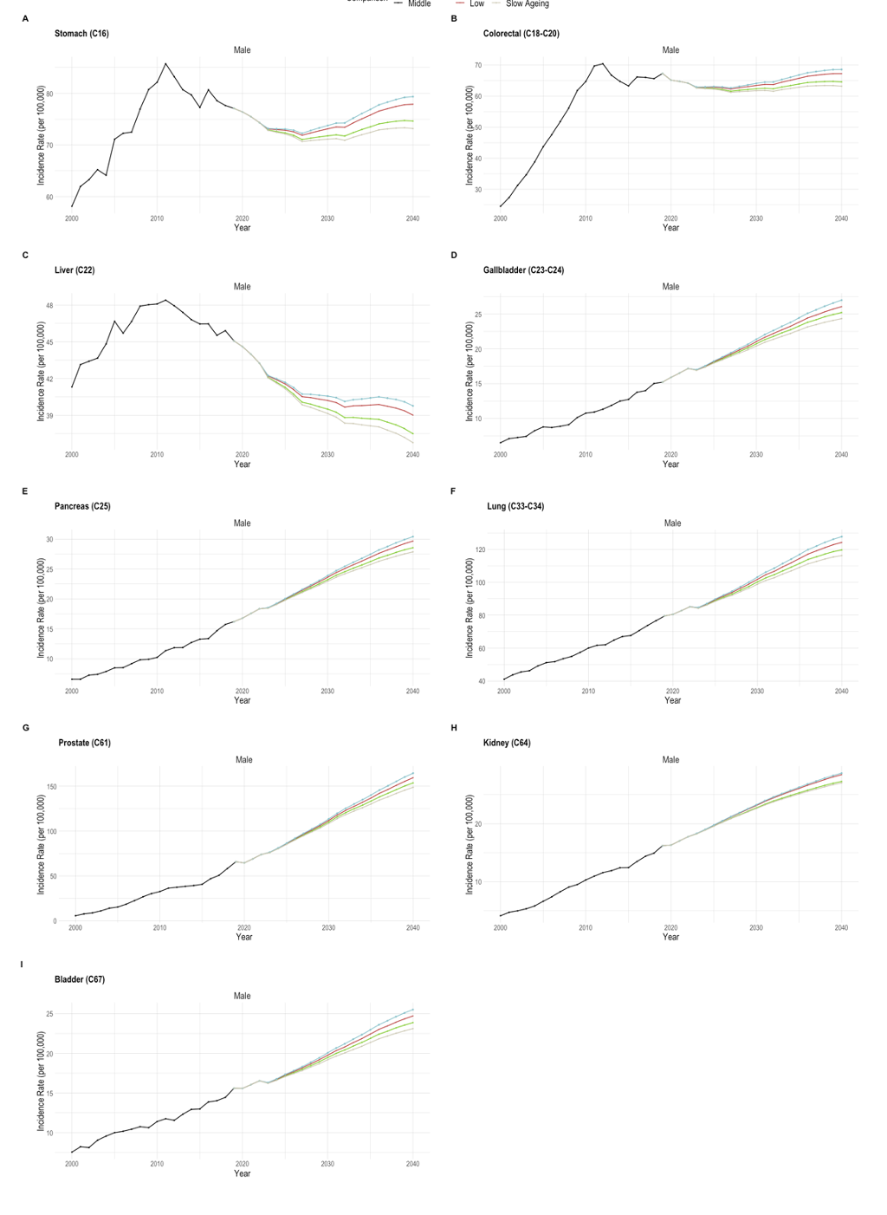
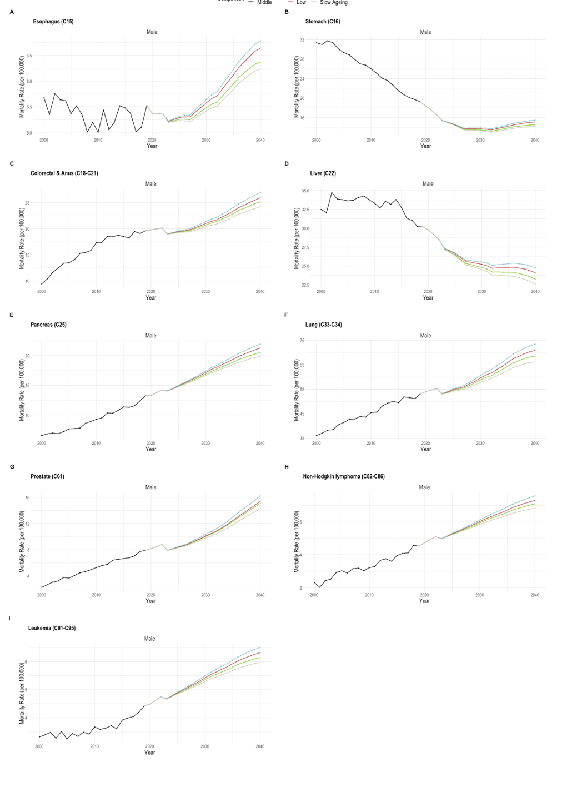
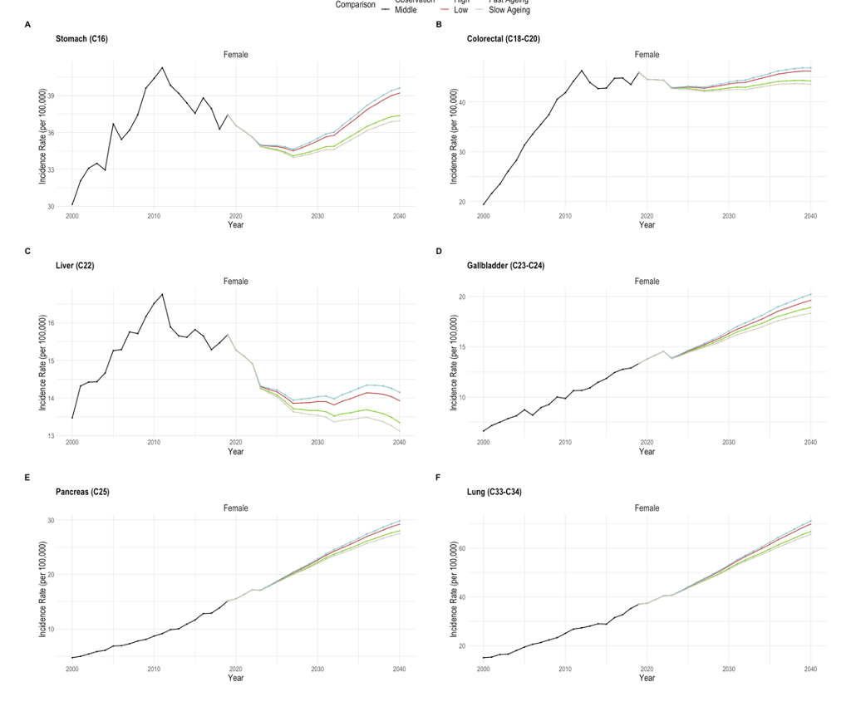
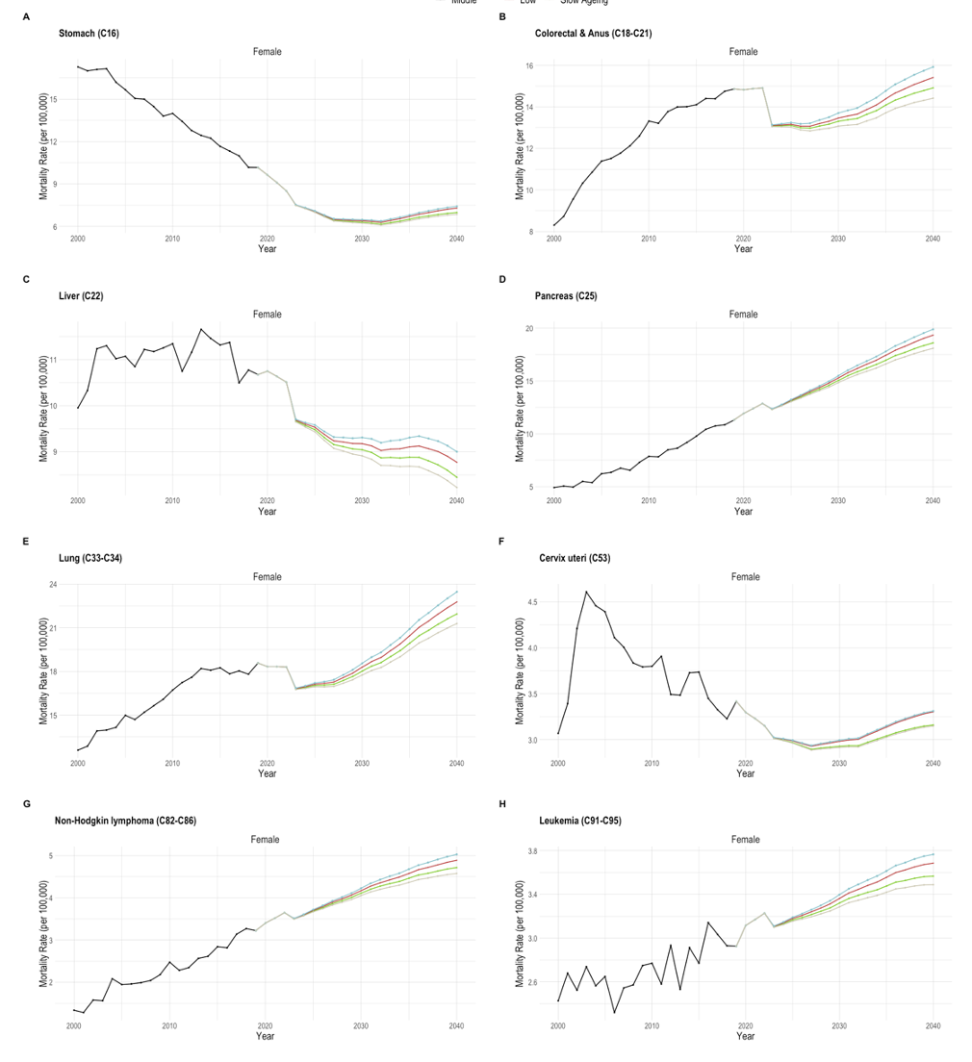
Result III: Compare projections from different scenarios by sex, cancer type
Scenarios (highest)
* Fast Ageing
Low
Median
High
Slow Ageing
The effects of population growth resulting from rising birth rates less those of population stagnation due to declining birth rates and aging population growth resulting from declining birth rates.
In fast aging societies, there is increase of over 10% in incidence and mortality rates than median estimates
Proejction by model, sex, cancer type
Introduction
Methods
Analysis & Results
Discussion
Conclusions
Notes:
The following results show the projections for each scenario.
The model used is the NORDPRED model, which was chosen because it was the most robustness among the models based on previous estimates results.
The ranking of the projections estimates per scenario is as follows:
These results can have the following interpretations
The effects of population growth resulting from rising birth rates less those of population stagnation due to declining birth rates and aging population growth resulting from declining birth rates.
In fast aging societies, there is average median increase of over 10% in incidence and mortality rates.

Slide 21
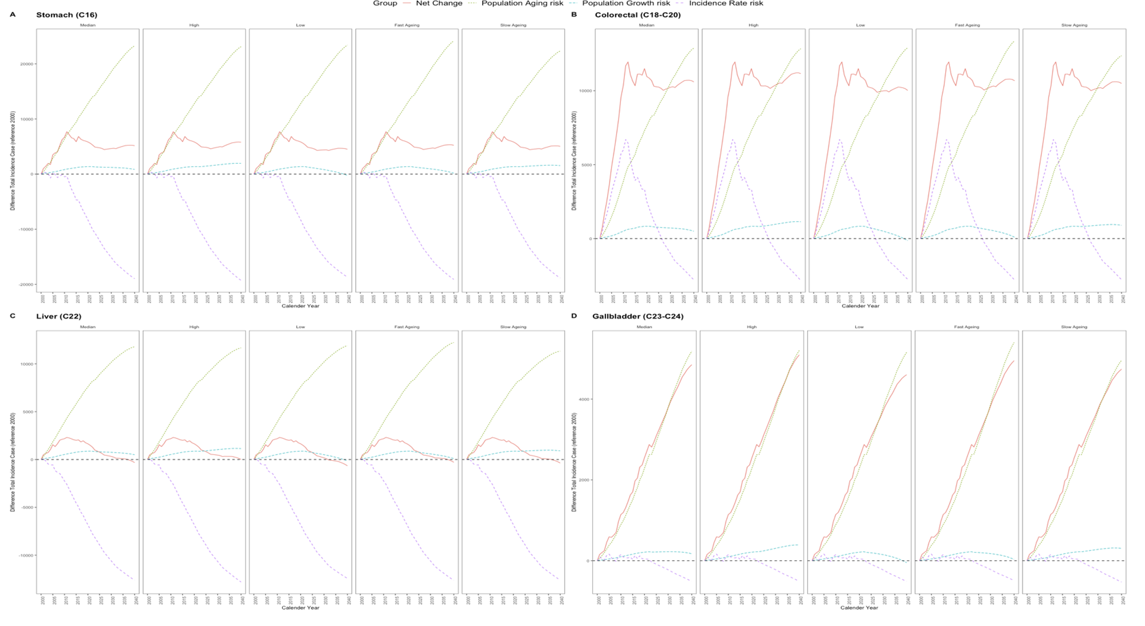
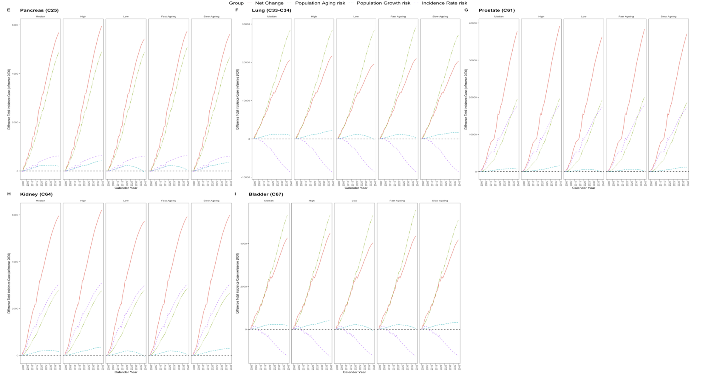
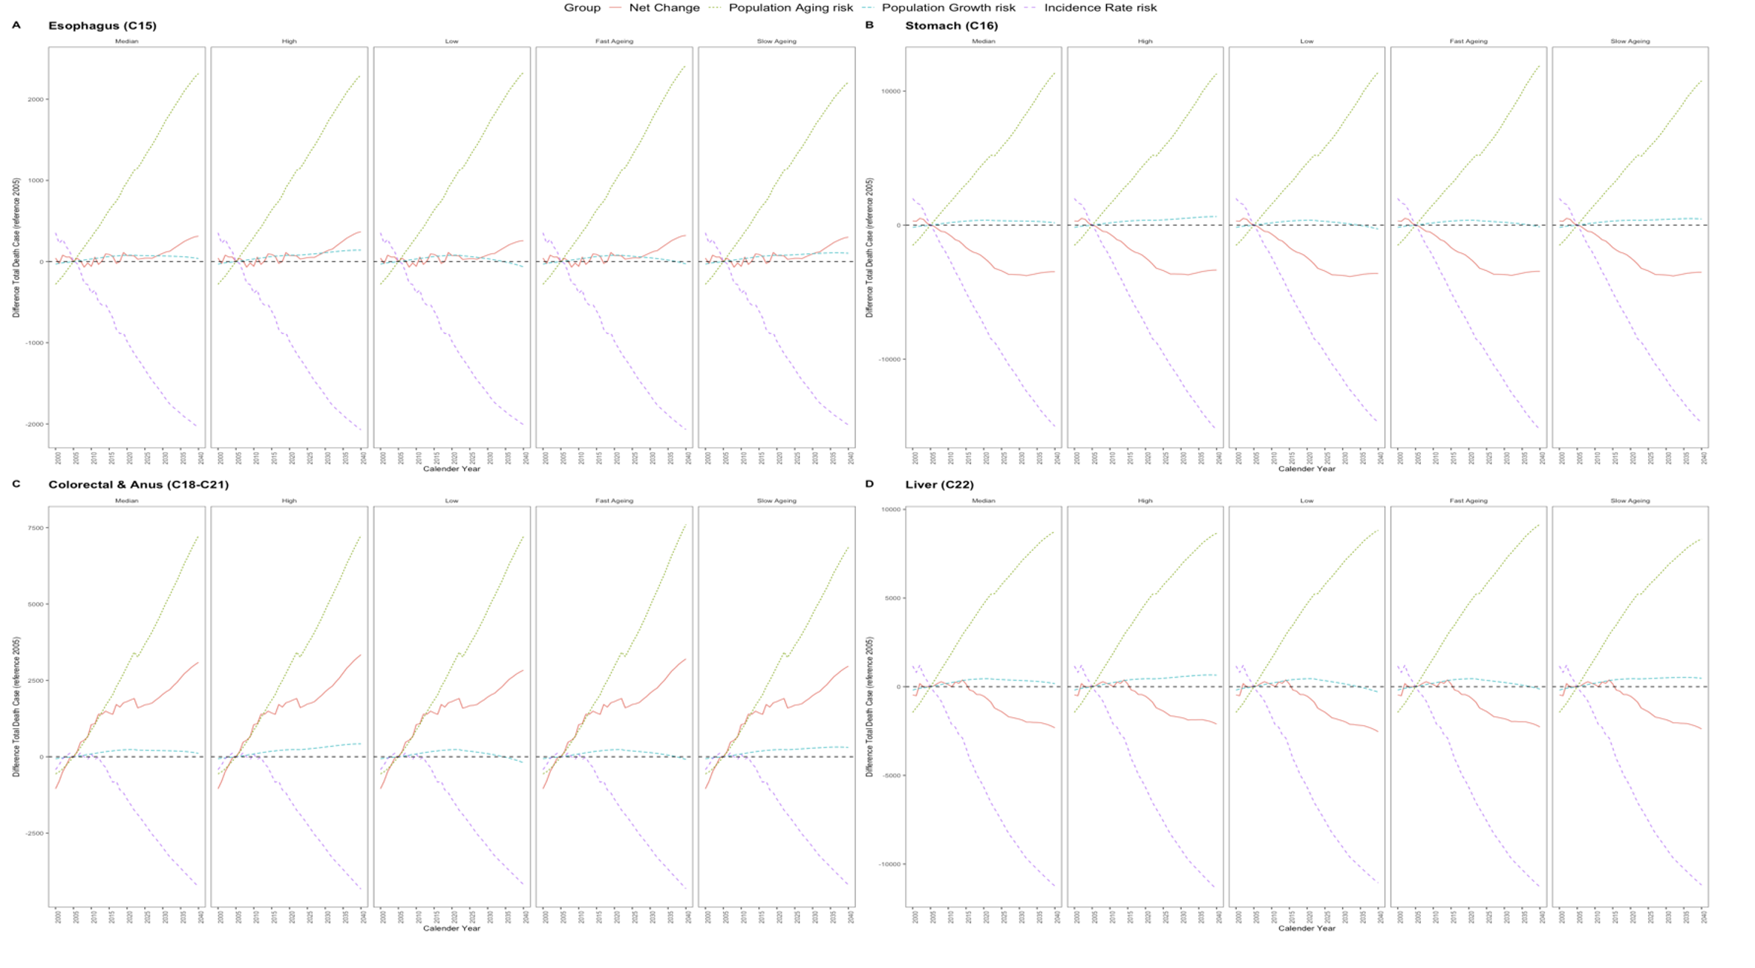
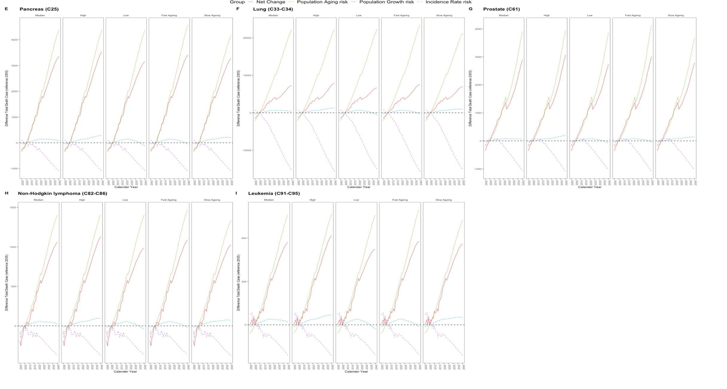
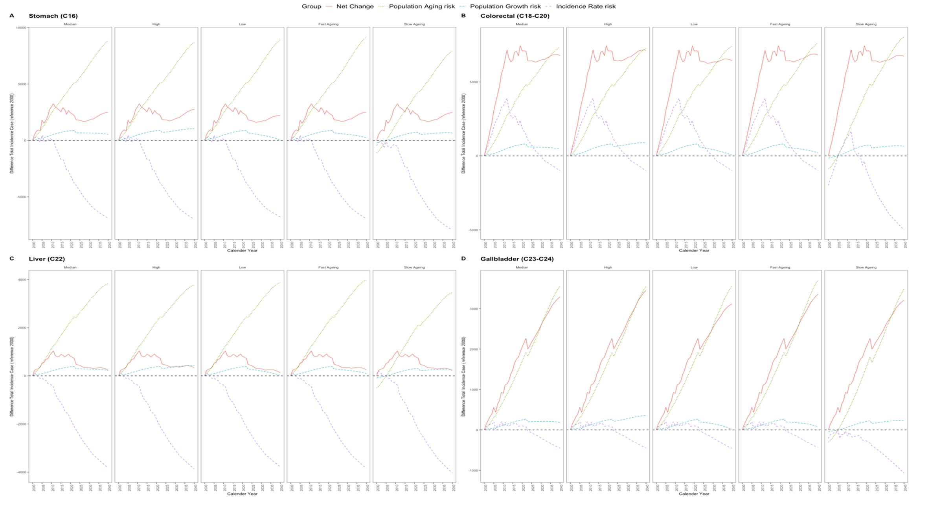
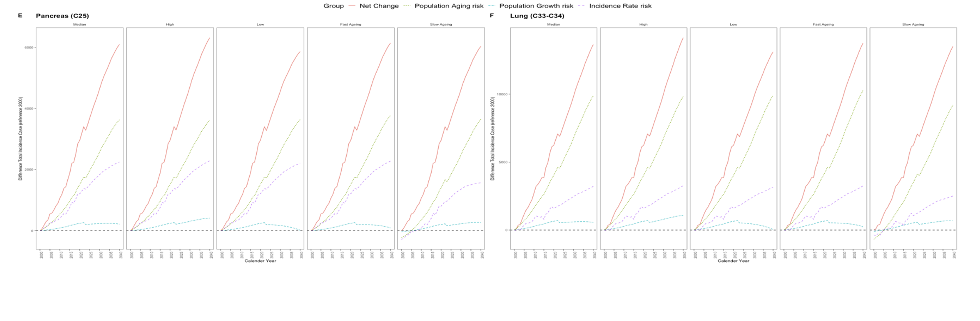
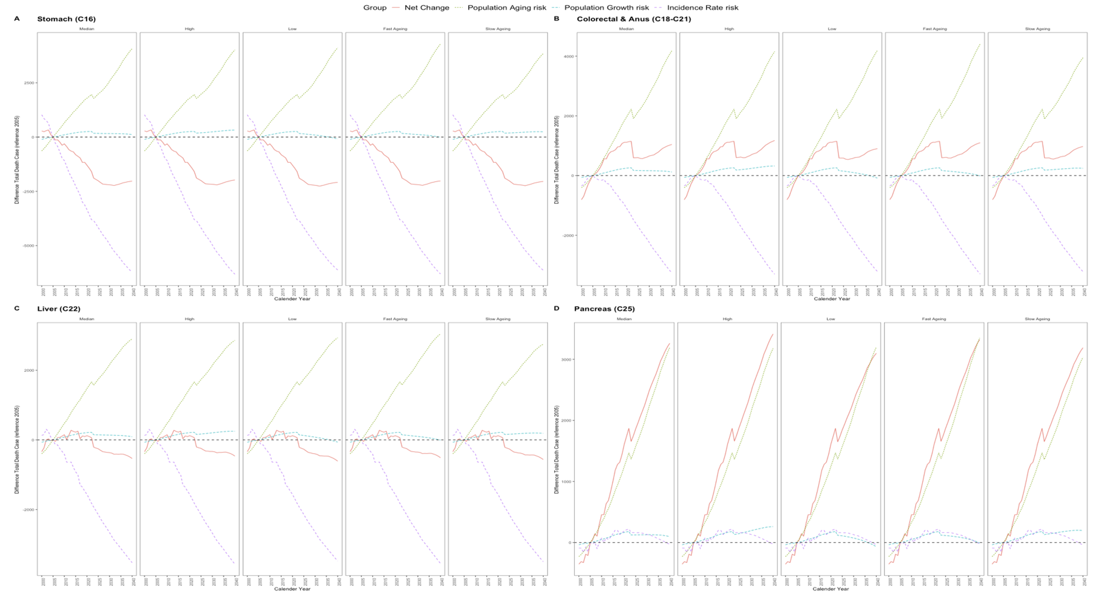
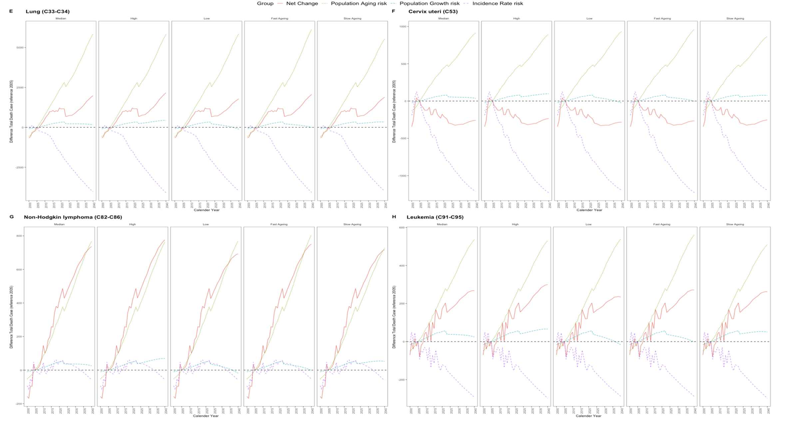
Result III: Compare decomposition projection by sex, cancer type
1) The impact of population growth factors on cancer incidence and mortality varies depending on the scenario, however, their contribution remains negligible.
2) Ageing factors demonstrate a greater impact on cancer incidence and mortality compared to other growth factors in all scenarios, except for prostate and kidney cancer in men.
3) The proportionate increase in ageing factors is proportional to the increase in the projection model.
Proejction by sex, cancer type
Introduction
Methods
Analysis & Results
Discussion
Conclusions
Notes:
The final result is a decomposition analysis based on the predicted results for each scenario.
From these results, we know common three key things.
1) The impact of population growth factors on cancer incidence and mortality varies depending on the scenario, however, their contribution remains negligible.
2) Ageing factors demonstrate a greater impact on cancer incidence and mortality compared to other growth factors in all scenarios, except for prostate and kidney cancer in men.
3) The proportionate increase in ageing factors is proportional to the increase in the projection model.

Slide 22
Discussion
FINDINGS
LIMITATION
1) The high contribution of ageing to cancer incidence and mortality
2) Developing into a fast aging society may contribute to the high cancer burden and the continuation of the current lower birth rate is problematic.
3) The need for appropriate model selection for different predictive values of different models
Short-term observations may reduce the predictive power of models.
The cancer registry during COVID-19 may lead to underestimates in future model fits for cancer incidence and mortality. However, since this is real recorded data, it is necessary to develop a suitable model to correct for this effect. (Because we can't afford not to use data from that period.)
Introduction
Methods
Analysis & Results
Discussion
Conclusions
Notes:
I will discuss the significance findings and limitations of our study.
in this perspective of findings,
And in this perspective of limitation,

Slide 23
Conclusion & Contribution
We found that the extent and contribution of aging to incidence/mortality is important.
We examine the extent of the disparity by analysing the varying estimates generated by the models.
We adjusted for future uncertainty based on scenario-based data.
The study contributes by identifying the impact of aging on cancer incidence and mortality, which can guide policymakers and healthcare professionals in program or policy to mitigate its effects.
1) Additional analysis and comparison based on new data
2) Model study and development for measuring the effect of ageing factors in the cancer prevalence model
FUTURE STUDY
Introduction
Methods
Analysis & Results
Discussion
Conclusions
Notes:
Finally, the conclusions and expected contributions are as follows.
Future studies through this study are as follows.

Slide 24
Thank you
Q & A
Notes:
Thank you for listening to the presentation.
If you have any questions about this presentation, please let us know.

